Slide 1
Digital Portfolio
STUDENT NAME: JANANI.M
REGISTER NO AND NMID: 24131091802522007/2287A6C949CB0019D4F4371AA5CB2CF0
DEPARTMENT: BSC COMPUTER SCIENCE
COLLEGE: COLLEGE/ UNIVERSITY. THIRUVALLUVAR ARTS AND SCIENCE COLEGE ANAMALAI UNIVERSITY

Slide 2
PROJECT TITLE
SIMPLE TIMER

Slide 3


AGENDA
Problem Statement
Project Overview
End Users
Tools and Technologies
Portfolio design and Layout
Features and Functionality
Results and Screenshots
Conclusion
Github Link
3/21/2024 Annual Review

Slide 4

PROBLEM STATEMENT
Time management is essential for productivity.
Users need a simple, clean, and interactive timer application.
Existing tools may be too complex for basic needs.

Slide 5

PROJECT OVERVIEW
A web-based timer application built using HTML, CSS, and JavaScript.
Provides start, pause, and reset functionalities.
Minimal and responsive design.

Slide 6

WHO ARE THE END USERS?
Students (study sessions, exams, practice).
Professionals (meetings, productivity tracking).
General users (daily tasks, workouts, reminders).

Slide 7
TOOLS AND TECHNIQUES
HTML5 – Structure
CSS3 (Tailwind CSS) – Styling & Layout
JavaScript (Vanilla JS) – Functionality & Timer logic
Font Awesome – Icons

Slide 8
POTFOLIO DESIGN AND LAYOUT
Start, Pause, and Reset the timer.
Smooth animations on buttons.
Real-time countdown display.
Lightweight and runs in browser (no installation).
‹#›

Slide 9
FEATURES AND FUNCTIONALITY
Start, Pause, and Reset the timer.
Smooth animations on buttons.
Real-time countdown display.
Lightweight and runs in browser (no installation).

Slide 10
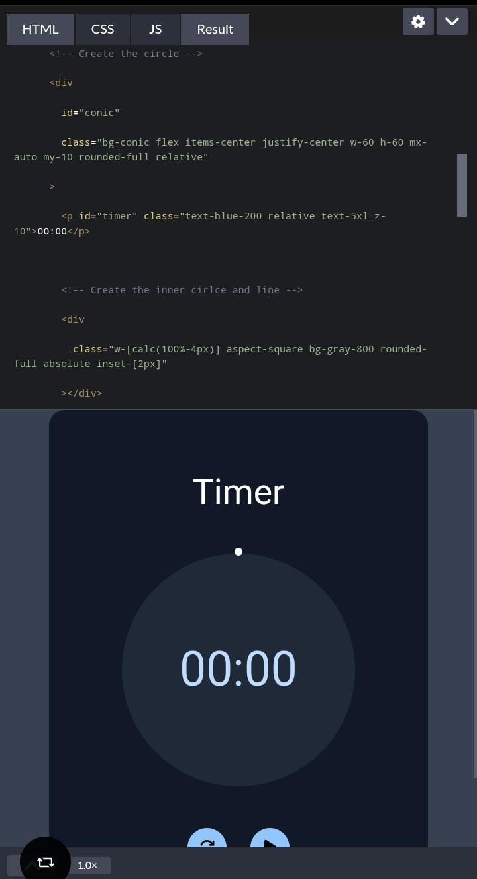
RESULTS AND SCREENSHOTS
3/21/2024 Annual Review
‹#›

Slide 11
CONCLUSION
Developed a simple, interactive timer.
Helps users manage time efficiently.
Can be extended with more features like alarms, countdowns, or themes.
Git Hub Link
https://github.com/jananipkk2007-ctrl/Janani--TNSDC-FWD-DP.git
‹#›

